Slide 1
Improvements in outcomes for patients with early breast cancer during the past 20 years
Presenter: Carolyn Taylor
Paul McGale, Jake Probert, John Broggio, Jackie Charman, Sarah Darby, Amanda Kerr, Tim Whelan,
David Cutter, Gurdeep Mannu, David Dodwell

Slide 2
Women with early breast cancer
Patient factors
Tumour factors
Breast cancer mortality
Long-term follow-up
Big data needed

Slide 3
Public Health England data
Women with breast cancer in England. Diagnosed 1993 to 2015
N=783,980
Exclusions
Other histology/non-invasive
Age <18 or 90+ years
Lost to follow-up, died or second cancer within 3 months
Probable metastatic disease
No surgery
Neoadjuvant chemotherapy
N=271,533
Women received surgery as first treatment for early breast cancer
N=512,447

Slide 4
Women with Early Invasive Breast Cancer 1993-2015
Follow-up | No. women starting follow-up period | %
Followed for at least 5 years | 300,501 | 57
10 years | 253,661 | 49
15 years | 130,621 | 25
20 years | 50,570 | 10
By end of follow-up (31 Dec 2020)
77,975 Breast cancer deaths

Slide 5
Breast cancer mortality:
Calendar year of diagnosis
N=512,447
Annual Cumulative
14%
5%

Slide 6
Breast cancer mortality:
Calendar year of diagnosis
Age 50-64 years by screen-detection
Screen-detected cancers
N=99,105
Non-screen-detected cancers
N=114,936

Slide 7
Breast cancer mortality: ER status
N=512,447
Annual mortality Cumulative mortality

Slide 8
Breast cancer mortality
Adjusted annual rates
Adjusted for:
- Time since diagnosis
- Calendar year of diagnosis
- Age at diagnosis
- Screen detection
- Laterality
- Index of multiple deprivation
- Region
Adjusted annual mortality rate %
1-20 21-50 >50
0 1 to 3 4 to 9 10 or more
Low Medium High

Slide 9
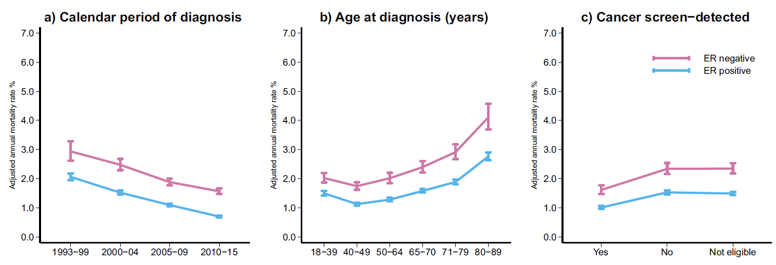
Breast cancer mortality
Adjusted annual rates
Adjusted for:
- Time since diagnosis
- Tumour size
- Number of positive nodes
- Tumour grade
- Laterality
- Index of multiple deprivation
- Region
Adjusted annual mortality rate %
1993- 2000- 2005- 2010-
1999 2004 2009 2015
18-39 40-49 50-64 65-70 71-79 80-89
Yes No Ineligible

Slide 10
Breast cancer mortality
Adjusted annual rates
Calendar year of diagnosis
Adjusted for:
- Time since diagnosis
- Screen detection
- Tumour size
- Number of positive nodes
- Tumour grade
- Laterality
- Index of multiple deprivation
- Region
Adjusted annual mortality rate %
1993- 2000- 2005- 2010-
1999 2004 2009 2015
1993- 2000- 2005- 2010-
1999 2004 2009 2015
1993- 2000- 2005- 2010-
1999 2004 2009 2015
1993- 2000- 2005- 2010-
1999 2004 2009 2015
1993- 2000- 2005- 2010-
1999 2004 2009 2015
1993- 2000- 2005- 2010-
1999 2004 2009 2015

Slide 11
Breast cancer mortality
Adjusted annual rates
Calendar year of diagnosis
Adjusted for:
- Time since diagnosis
- Age
- Tumour size
- Number of positive nodes
- Tumour grade
- Laterality
- Index of multiple deprivation
- Region
1993- 2000- 2005- 2010-
1999 2004 2009 2015
1993- 2000- 2005- 2010-
1999 2004 2009 2015
1993- 2000- 2005- 2010-
1999 2004 2009 2015

Slide 12
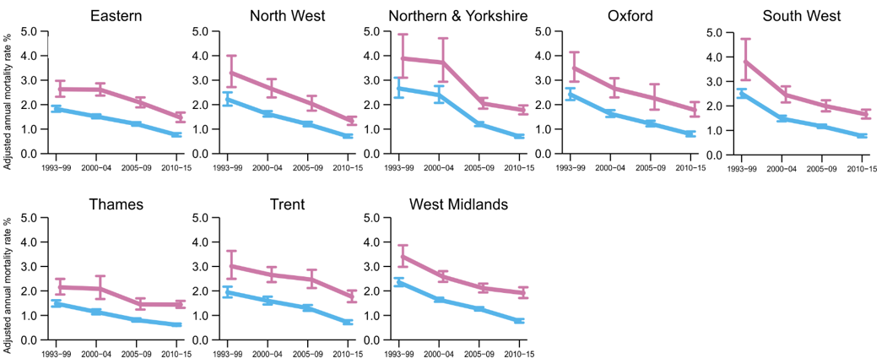
Adjusted for:
- Time since diagnosis
- Age
- Screen detection
- Tumour size
- Number of positive nodes
- Tumour grade
- Laterality
- Index of multiple deprivation
Breast cancer mortality
Adjusted annual rates
Calendar year of diagnosis

Slide 13
Breast cancer mortality:
Calendar year of diagnosis
N=512,447
Annual Cumulative

Slide 14
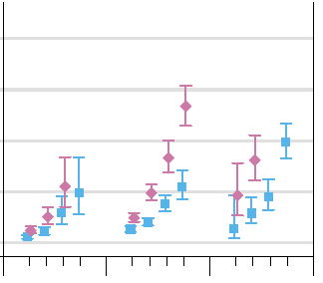
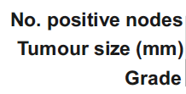
Cumulative 5-year breast cancer risks
Women diagnosed 2010-2015
N=28,892
Cumulative 5-year breast cancer mortality risk (%)

Slide 15
Conclusions
Data on 500,000 women in England, followed for up to 20 years
Average 5-year risk of dying from breast cancer has fallen from 14% to 5% since the 1990s
For 63% of women diagnosed 2010-2015 risk was <3%
For 5% of women diagnosed 2010-2015 risk was >20%
Most women diagnosed with early invasive breast cancer today can expect to become long-term cancer survivors

Slide 16
Thanks to …
Half a million women in the study
Two patient advocates who informed it
Many researchers in Public Health England and in Oxford Population Health

Slide 17
Cancer patients can make a difference …

Slide 18
Questions

